Slide 1


Date
Apr 17, 2025
RevoBank
Customer Segmentation & Paylater Customer Prediction
by
Batch
Assignment
Linkedin
Link
Ahmad Rizki
RevoU FSDA batch FEB25
Advance
Python
www.linkedin.com/in/arizabdulhanan
Google Collab Link

Slide 2
Business Overview &
Scope of Project
As a Data Analyst at RevoBank, which based in Europe, we are asked to summarizing the sales performance from the past three years and creating user personas based on the existing clients by our manager.
Working together with the performance management (PM) team, whose has the goals to encourage existing customers to use RevoBank credit card products more, we received a data summary about detailing clients and their sales over the last three years (36 months) from the MIS (Management Information System).
The banks earn profit of 2.4% from total sales amount.

Slide 3
Problem Statement
“How to understand the client’s behavior by summarizing the sales performance from the past three years, creating user personas based on existing clients, and identifying business opportunities to select the right promotional methods based on several user categories in order to encourage existing customers to use RevoBank credit card products more ?”

Slide 4
Analytical Objective
The goal of this analysis is to understand the client’s behavior by summarizing the sales performance from the past three years, creating user personas based on existing clients, and identifying business opportunities to select the right promotional methods based on several user categories in order to encourage existing customers to use RevoBank credit card products more.

Slide 5
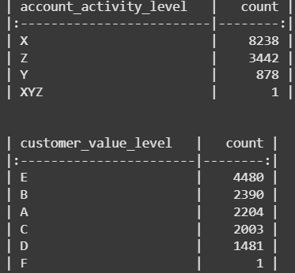
Data Preparation
Removed typo data
After checking, we found some typo data in the dataset. We can not found ‘XYZ’ value on account_activity_level column and ‘F’ value on customer_value_level column in data dictionary. So, it needs to be removed because there is no strong reason to replace the data with other data, and also to avoid misleading.

Slide 6
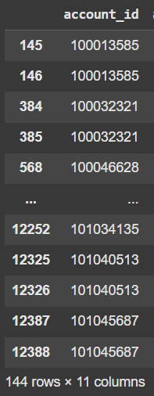
Data Preparation
Treat duplicates
After checking, we found there is 144 rows duplicates data in total related to account_id that is not unique. So, it need to be removed because we only need one unique row from the duplicates. This is to ensure data quality, optimize analysis, and maintain the accuracy and reliability of insights derived from the data

Slide 7
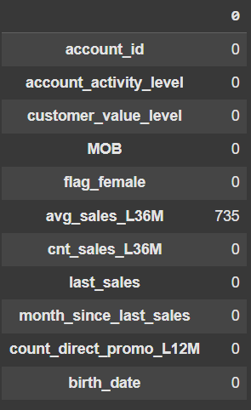
Data Preparation
Treat missing values
After checking, we found there is 735 rows that have missing value on column avg_sales_L36M. Because we can find out how to fill that missing by looking at minimum value of month_since_last_sales column from all rows that have missing value is 39, which means the missing value in the avg_sales_L36M column refers to customers with no active transactions for the last 36 months. So, the missing value can we replace with 0 or no active transactions.

Slide 8
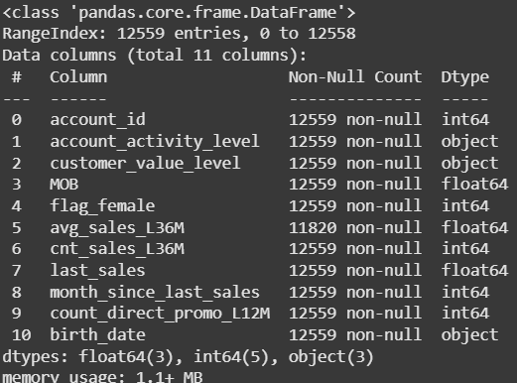
Data Preparation
Convert data type
After checking, we found account_id, MOB, and birth_date is not in the right data type for doing calculation or else.

Slide 9
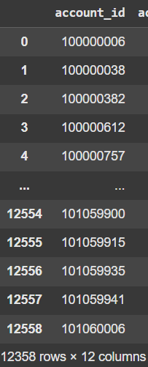
Data Preparation
Remove client with age < 21
After checking, we found only 12.358 clients who are over 21 years old according to the instructions of the question.

Slide 10
Data Preparation
Data Cleaning Steps | Original Data | After Cleaning | Reasons
Removed typo data | “F” value on customer_value_level column and “XYZ” value on account_activity_level column | remove the “F” value on customer_value_level column and “XYZ” value on account_activity_level column | “F” value and “XYZ” value are not in data dictionary, and it only have one row for each column.
Treat duplicates | Total 12.557 rows | Remaining 12.485 rows | Need to remove 72 rows duplicate rows which caused by account_id is not unique. Deleting duplicates is essential for ensuring data quality, optimizing analysis, and maintaining the accuracy and reliability of insights derived from the data.
Treat missing values | Total 12.485 rows | Still 12.485 rows | Impute 735 rows that missing values on avg_sales_L36M with 0 value, because we still using the transaction record for every account and also can find out how to fill that missing.
Convert to the correct data type | account_id dtype integer, MOB dtype float, and birth_date dtype object | account_id dtype object, MOB dtype integer, and birth_date dtype datetime | Because, account_id must be in object type to ensures flexibility, consistency, and correctness in how they're formatted and used. MOB also need to be in integer type for calculation purpose. And birth_date must be in datetime type, because it will be processed based on date calculation.
Remove all client with age < 21 | Total 12.485 clients | Remaining 12.358 clients | Because asked in the question.

Slide 11
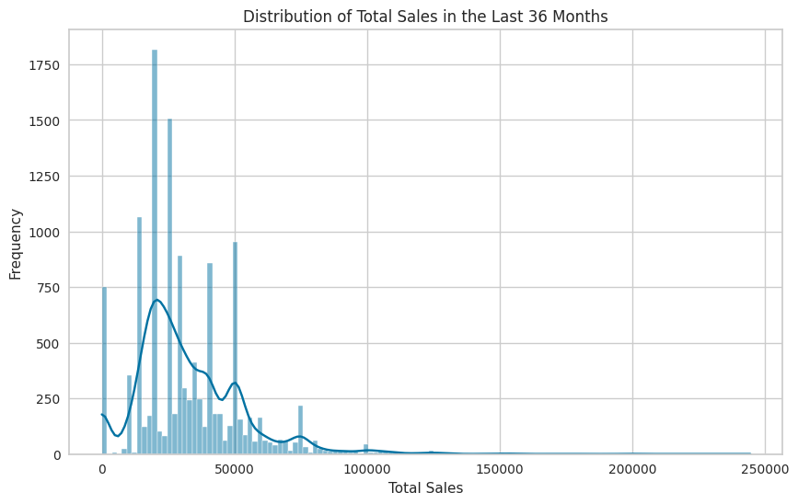
Exploratory Data Analysis
Question
A. Calculate the total sales in the past 3 years.
Insights
-Total sales from all customers in the past 3 years is 402,603,860 euros.
-This suggests a right-skewed distribution: a small number of customers have very high sales, pulling the average up.
-50% of customers spend between 20,000 and 42,000.
–The maximum sale is 244,400, far above the average.
-The average (32,578) is pulled up by big spenders, but the median (28,000) is lower.
-A minimum of 0 means there are inactive customers.
-The standard deviation is quite high (21,156), showing wide differences in customer value.

Slide 12
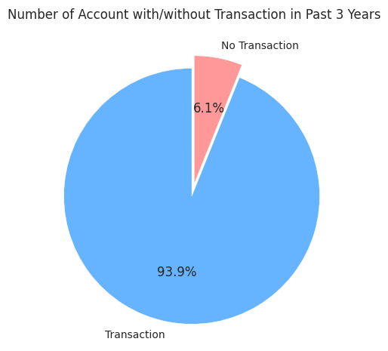
Exploratory Data Analysis
Question
B. Identify the number of clients with no sales in the past 36 months. What percentage does this represent compared to the total number of client?
Insights
-With 93.9% making purchases, your customer base is highly engaged.
-Only 6.1% didn’t buy anything in 3 years
-With such a small inactive group, the focus can be more on increasing spend per customer, launching loyalty programs, or upselling.

Slide 13
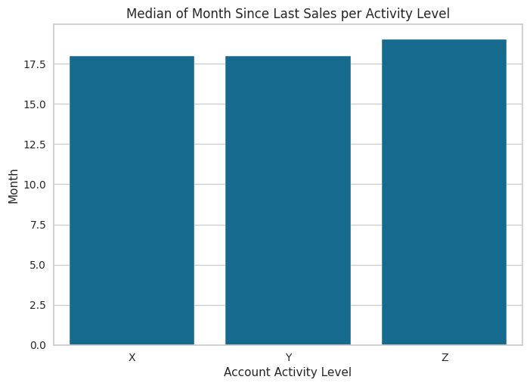
Exploratory Data Analysis
Question
C. In the data dictionary, the account activity "X" is said to be the most active transacting compared to other levels. Is it true? Present your findings in a data visualization.
Insights
Based on median of month since last sales per activity level data, we can see that account activity “X” and “Y” has more productive result than account activity “Z” with the longest month since last sales for 18 months.

Slide 14
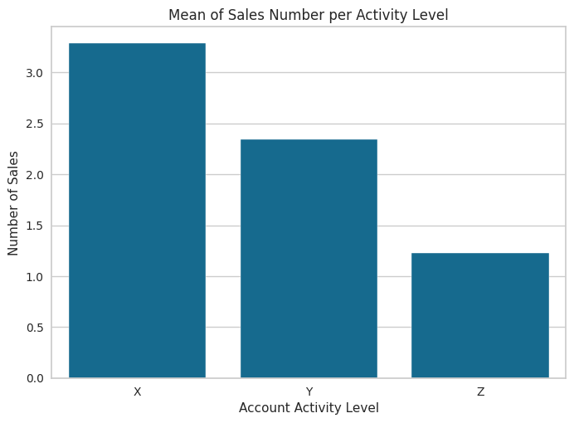
Exploratory Data Analysis
Question
C. In the data dictionary, the account activity "X" is said to be the most active transacting compared to other levels. Is it true? Present your findings in a data visualization.
Insights
Based on mean of sales per activity level data, we can see that account activity “X” has the most productive result which describe from the number of mean of sales for 3.28. It means that account activity “X” averaged do 3.28 transactions per account in the past 3 years.

Slide 15
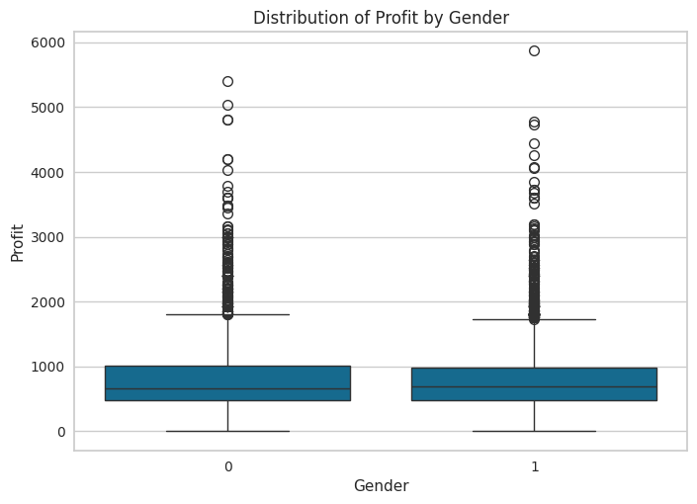
Exploratory Data Analysis
Question
D. Is it true that male clients generate higher profits compared to female clients?
Insights
Even though, on average, each male brings in a bit more profit (788) than each female (776), the total profit from females is actually higher for about 5.19 million euros compared to 4.48 million euros from males.

Slide 16
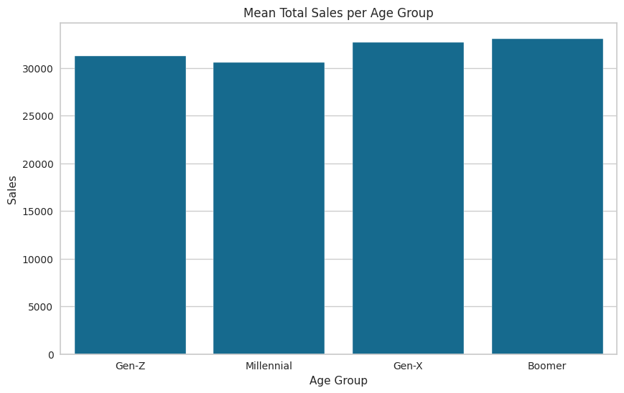
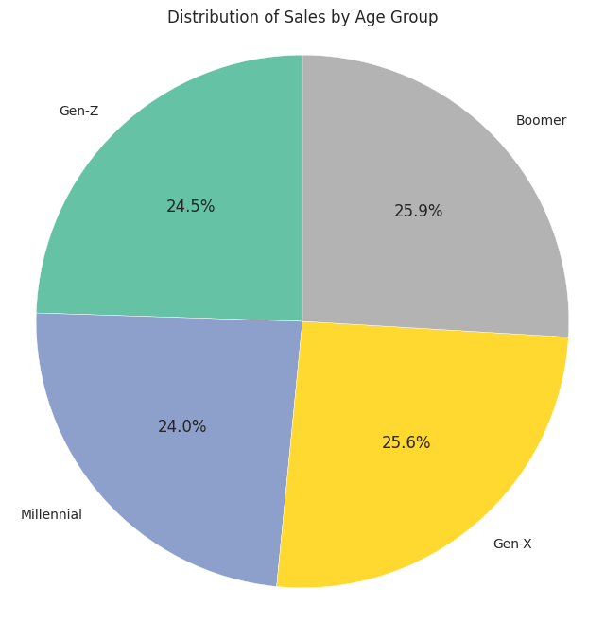
Exploratory Data Analysis
Question
E. Calculate the proportion of total sales in the past 3 years based on generations (Boomer, Gen-X, Milenial, Gen-Z, Gen-Alpha). Does the total sales skew toward a certain demographic group? If so, what is your recommendation for the bank to improve sales performance? Present your findings in a data visualization.

Slide 17
Exploratory Data Analysis
Question
E. Calculate the proportion of total sales in the past 3 years based on generations (Boomer, Gen-X, Milenial, Gen-Z, Gen-Alpha). Does the total sales skew toward a certain demographic group? If so, what is your recommendation for the bank to improve sales performance? Present your findings in a data visualization.
Insights
-There’s a noticeable skew in total sales toward older generations, especially Boomers and Gen X.
-Boomers have the highest average total sales at 33,076 euros, followed closely by Gen X at 32,660 euros. On the other hand, Gen Z lags behind with an average of 21,238 euros, which is quite a bit lower than the others.

Slide 18
Exploratory Data Analysis
Question
E. Calculate the proportion of total sales in the past 3 years based on generations (Boomer, Gen-X, Milenial, Gen-Z, Gen-Alpha). Does the total sales skew toward a certain demographic group? If so, what is your recommendation for the bank to improve sales performance? Present your findings in a data visualization.
Recommendation for The Bank
-Gen Z and Millennials have a lot of potential, but right now their average sales are lower. The bank can focus on creating products that really fit where they are in life things like budgeting tools, savings plans, or first-time buyer support.
-Gen X and Boomers are already strong contributors, so it’s important to keep that going. Offering them added value like retirement planning, wealth management, or premium services can deepen those relationships.
-The bank could also look at cross-generational opportunities. For example, a referral program where Boomers refer their kids or grandkids could bring in younger customers while rewarding older ones. Personalized outreach based on life events like getting married or planning for retirement could also make a big impact.

Slide 19
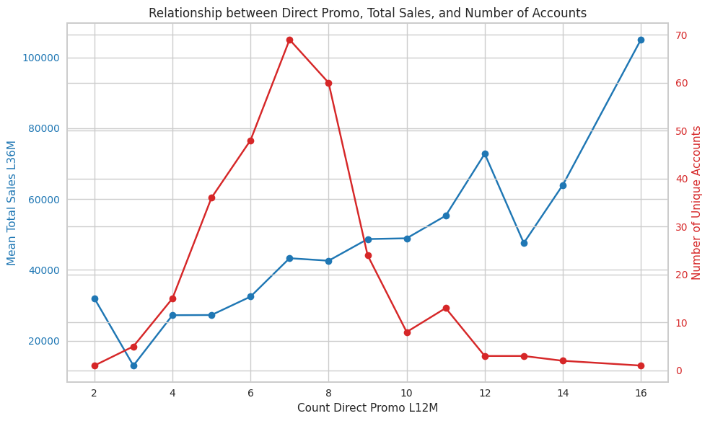
Exploratory Data Analysis
Question
F. Is there a relationship between increasing the number of email and SMS messages and improved total sales performance? If so, what is your recommendation for the bank to improve its sales performance? Present your findings in a line chart.
Insights
-There are a positive relationship between how often the bank reaches out to customers via email and SMS, and how much those customers end up spending. The data shows that as the number of messages goes up, so do the total sales.
-People who got just 2 to 5 messages over the past year typically spent under 33,000 euros in total.
-But once customers started getting 10+ messages, their total sales jumped over 70,000 euros at 12 messages, and more than 100,000 euros at 16.

Slide 20
Exploratory Data Analysis
Question
F. Is there a relationship between increasing the number of email and SMS messages and improved total sales performance? If so, what is your recommendation for the bank to improve its sales performance? Present your findings in a line chart.
Recommendation for The Bank
-If customers are spending more when they’re contacted more often, then the bank should consider increasing the number of email and SMS promotions, especially for customers who are already somewhat engaged.
-Use the information about each customer (like their age group, past behavior, or interests) to tailor the content so it feels helpful, not spammy.
-Try out different frequencies and see what sticks. Some customers may respond well to monthly updates; others might prefer something less frequent.
-The customers getting the most messages are also bringing in the most revenue, so it’s worth investing in this kind of engagement, not just for one-off campaigns, but as part of an ongoing relationship strategy.

Slide 21
Customer Segmentation
Question
a. What is the best clustering method to form segments of this project? Explain the reason.
Answer
We choose k-means clustering method to make customer segmentation for several reason :
- Handles multiple features (demographic, behavioral, transactional) and can identify complex relationships in the data than RFM method;
- Offers data driven segmentation without predefined categories or assumption;
- Allows for scalability, especially with large datasets;
- Uncovers hidden patterns and provides more granular customer segments;
- Highly flexible in terms of customization, and allows for dynamic, evolving segmentation as new data comes in.

Slide 22
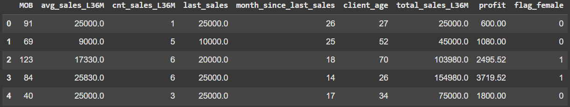
Customer Segmentation
Question
b. Make sure to carefully choose the appropriate cluster using techniques such as segment mapping, the elbow meethod, silhouette score, silhouette analysis, or other relevant metrics for the selected method.
Answer
We choose several numeric features to make scaling. But, there is flag female column that must be transform with one hot encoding earlier for scaling process.

Slide 23
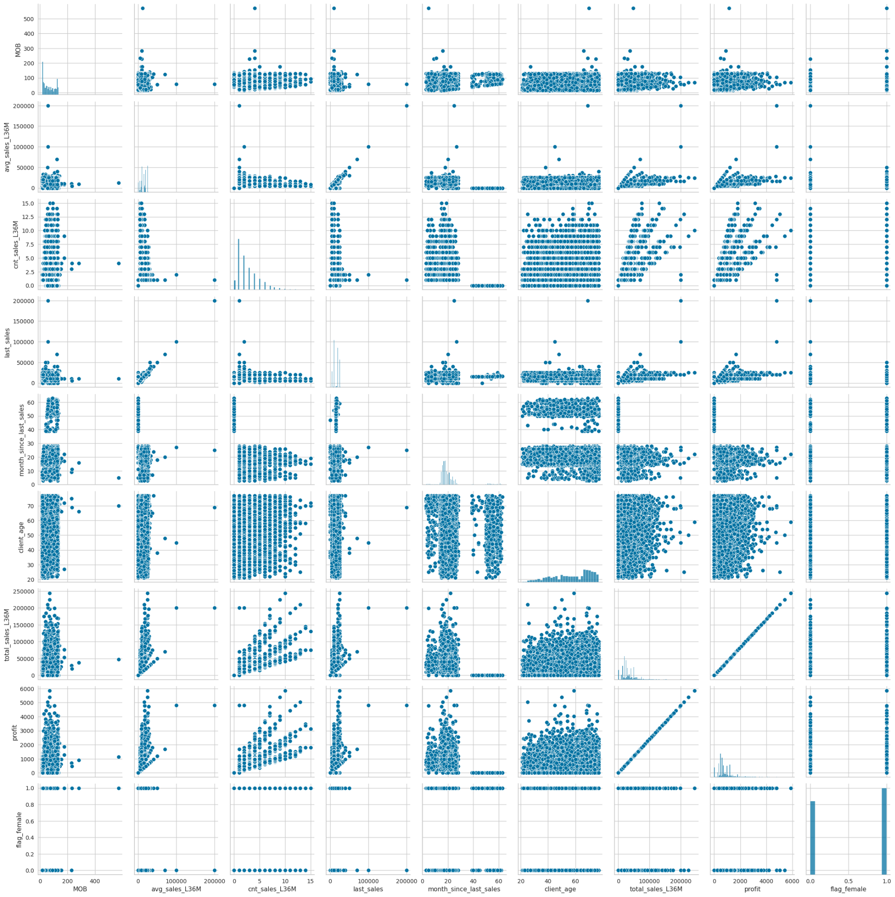
Customer Segmentation
Question
b. Make sure to carefully choose the appropriate cluster using techniques such as segment mapping, the elbow meethod, silhouette score, silhouette analysis, or other relevant metrics for the selected method.
Answer
After we see the segment mapping, we can’t determine the number of segments that need to be created because from the mapping results, we cannot find a pattern from the existing segment mapping, and also the number of variables is quite large.

Slide 24
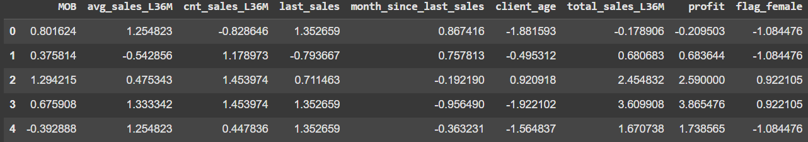
Customer Segmentation
Question
b. Make sure to carefully choose the appropriate cluster using techniques such as segment mapping, the elbow meethod, silhouette score, silhouette analysis, or other relevant metrics for the selected method.
Answer
We decide using PowerTransformer technique on feature scaling, because the dataset has an extreme skew distribution.

Slide 25
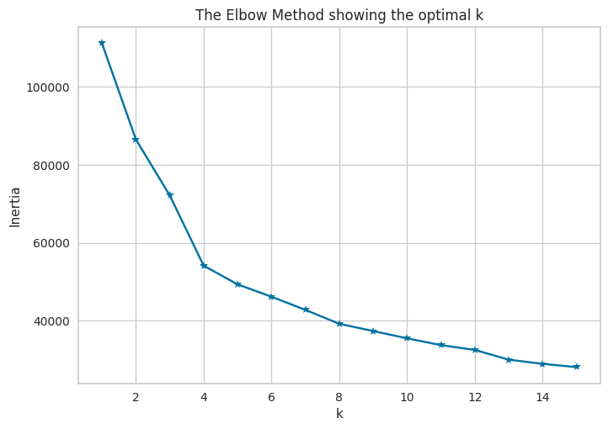
Customer Segmentation
Question
b. Make sure to carefully choose the appropriate cluster using techniques such as segment mapping, the elbow meethod, silhouette score, silhouette analysis, or other relevant metrics for the selected method.
Answer
After we see the result from elbow method to show the optimal k number, we decided to continue using the silhouette method to ensure the optimal k number between 4-8.

Slide 26
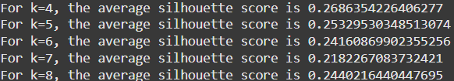
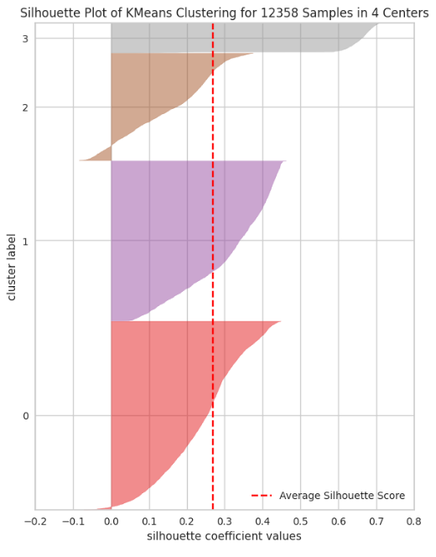
Customer Segmentation
Question
b. Make sure to carefully choose the appropriate cluster using techniques such as segment mapping, the elbow meethod, silhouette score, silhouette analysis, or other relevant metrics for the selected method.
Answer
After we see the result from silhouette method, we decide to choose 4 as k number for several reason :
- Has the highest avg. silhouette score
- The size/proportion of the silhouette tends to be more similar than the others
- There are only 2 negative silhouettes

Slide 27
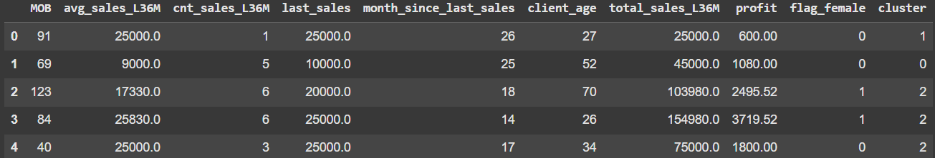
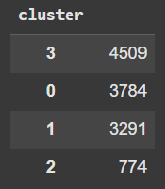
Customer Segmentation
Question
b. Make sure to carefully choose the appropriate cluster using techniques such as segment mapping, the elbow meethod, silhouette score, silhouette analysis, or other relevant metrics for the selected method.
Result
The result shows that cluster 3 has the largest number of client, followed by cluster 0, cluster 1, and cluster 2.

Slide 28
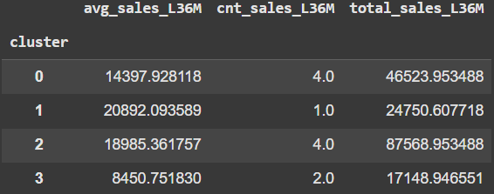
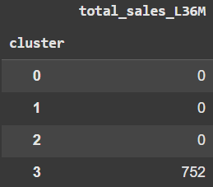
Customer Segmentation
Question
c. Identify the segments that have higher average sales per client, higher average transaction frequency per client, higher revenue generated, and/or a larger proportion of clients with no sales!
Answer
- Cluster 1 (High-Value Customers) has the highest average sales per client with 20,892.09 euros.
- Cluster 0 (Loyal Customers) and 2 (Big Spenders) has the highest quantity of sales per client with 4x.
- Cluster 2 (Big Spenders) has the highest total sales per client with 87,568.95 euros.
- Cluster 3 (Churned/Inactive Customers) has the largest proportion of clients with no sales with 752 clients.

Slide 29
Customer Segmentation
Question
d. re-read the business background, and identify business opportunities associated with the user persona in your result. To gather user persona, don't forget to interpret the created clusters.
Answer
Business Opportunities:
Cluster 0 (Loyal Customers) : These customers are consistent and reliable. You could offer exclusive discounts, special deals, or even give them access to early product releases.
Cluster 1 (High-Value Customers) : These are the ones who like to splurge when they do buy. They could really appreciate personalized experiences maybe offering them exclusive offers or giving them access to high-end products that cater to their taste.
Cluster 2 (Big Spenders) : These customers are the golden goose. The goal here is to keep them engaged by offering bundles, VIP loyalty perks, or even early access to new products.
Cluster 3 (Churned/Inactive Customers) : These customers used to buy but haven’t in a while, and some haven’t made a purchase in over 3 years. With the right re-engagement campaigns, maybe can bring them back perhaps through personalized offers or discounts to win them over again.

Slide 30
Customer Segmentation
Question
d. re-read the business background, and identify business opportunities associated with the user persona in your result. To gather user persona, don't forget to interpret the created clusters.
Answer
I think two segments that must be focus on because more likely giving more profit than the others is Big Spenders and Loyal Customer. Since Big Spenders already spending the most 87,568 total sales, and they buy frequently, and also Loyal Customer that consistent over the years, and that loyalty is golden for RevoBank.

Slide 31
Business Recommendation
Question
e. After you identify the business opportunities, please give your business recommendation for Performance Management Lead.
Answer
To get existing customers to use their RevoBank credit cards more, the key is to personalize the experience and reward their loyalty.
- For loyal customers, let’s offer exclusive deals and early access to new products.
- For high-value spenders, we should focus on providing luxury experiences and personalized rewards.
- For big spenders, it’s all about keeping them engaged with VIP perks and bundles.
- For the inactive customers, we need to re-engage them with special offers and rewards reminders.

Slide 32
Date
April 17, 2025
Additional
Machine Learning
by
Batch
Assignment
Linkedin
Ahmad Rizki
RevoU FSDA batch FEB25
Advance
Python
www.linkedin.com/in/arizabdulhanan

Slide 33
Question
1. Identify important columns that can be used for joining the transactions behavior table. Take note of any special values defined in the dictionary, if any.
Answer
Important columns in pilot dataset that can be used for joining the transaction behavior table is account_id.
- xsell_success : Accounts coded with a 1 contracted for at least one product in the previous campaign season. Accounts coded with a zero did not contract for a product in the previous campaign season.
- xsell_sales : The amount of financial services product (sum of sales) per account in the previous campaign season, denominated in euros.
- xsell_count : The number of financial services products (count) per account in the previous campaign season.

Slide 34
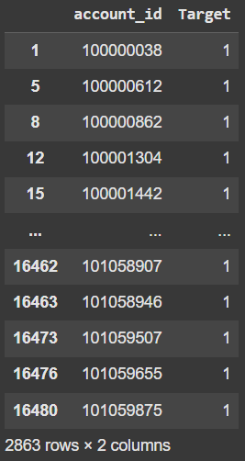
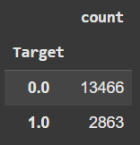
Question
2. Clearly state the target variable of the propensity model in your presentation. Define the past, present, future periods for the model.
Answer
We choose the target variable for customer that already activating and using Paylater. So, we need to find out customer that have xsell_success = 1 (which means already contracted for at least one product in the previous campaign season) and xsell_sales > 0 (which means the transaction amount is not 0)
- Past period : <= 31 May 2023
- Present period : 31 May 2023
- Future period : June 2023 - August 2023

Slide 35
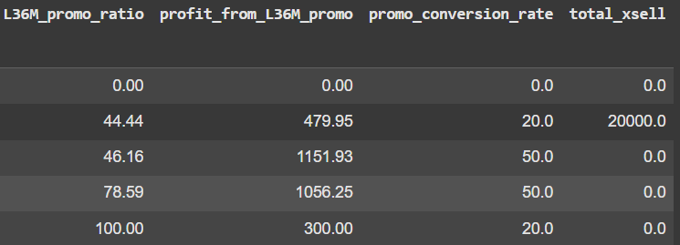
Question
3. Utilize your knowledge about the dataset (from EDA and clustering results in the Intermediate Assignment) along with additional exploration. You might want to create new features for the propensity model, ensuring that data from the future is excluded. Encode categorical variables appropriately.
Answer
- We add some features according to analysis propensity model. But for data xsell-related, we will remove from dataset after we doing correlation test along with remove variable with high coefficient correlation , before make a model.
- We need to encode categorical column.

Slide 36
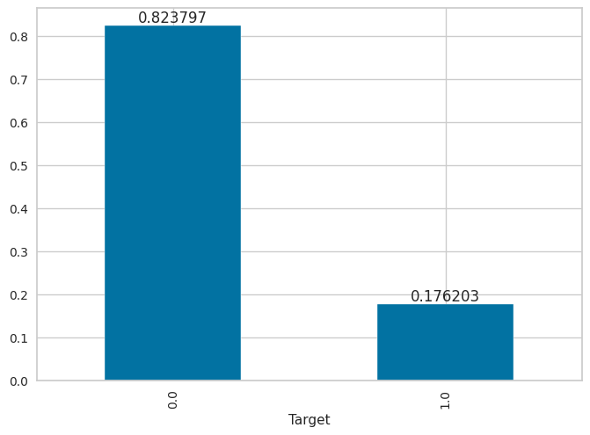
Question
4a. Check whether the training data is an imbalanced dataset
Answer
We choose logistic regression to make a model, because the target is a categorical value. And we need to use class_weight, because the dataset is imbalance.
After we check the training data, we found that training data is imbalanced, because the dataset just has data of target = 1 only 17.63% (below 30%). On the other hand, data of target = 0 is 82.37%.

Slide 37
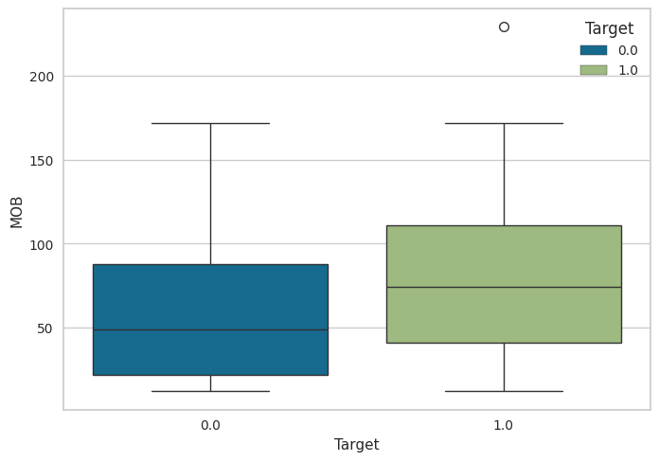
Question
4b. Features check in boxplot and heatmap are optional, but you can add them if needed.

Slide 38
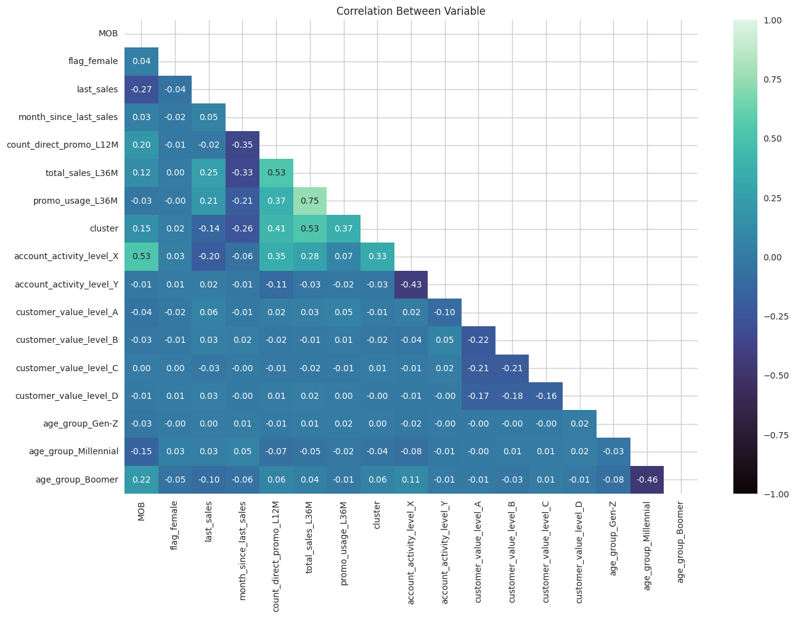
Question
4c. Conduct a correlation check on the training dataset to check on the multicollinearity, and report the result in your presentation, including any variable removal you may do.
Answer
- After we check the multicollinearity, we need to remove one of two data that has high correlation coefficient to avoid data similar. And also xsell-related variable that must be remove before.
- After we check with VIF method, we found that count_direct_promo_L12M and total_sales_L36M has a VIF score above 10 which must be excluded. But we decide to keep that data because that data is important.

Slide 39
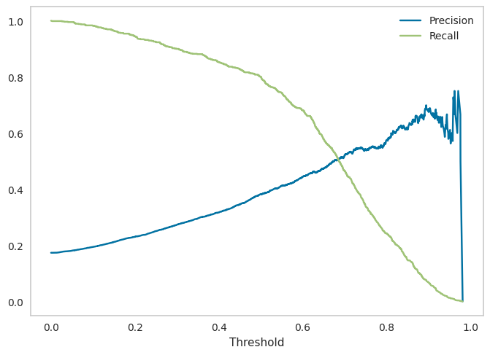
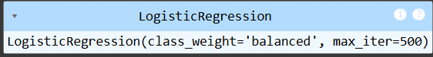
Question
5. Build a model to predict the target variable using the training dataset.
Answer
We choose logistic regression to make a model, because the target is a categorical value. And we need to use class_weight, because the dataset is imbalanced.

Slide 40
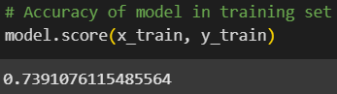
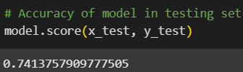
Question
6a. Assess the accuracy of the model's predictions in both the training and test datasets. Is there a noticeable in accuracy between the two?
Answer
It can be seen that our model:
- successfully predicted 73.9% of the data correctly in the training set,
- predicted 74% correctly in the testing set.
So, there is no sign of overfitting, although there is a possibility that the model is underfit due to its low accuracy.

Slide 41
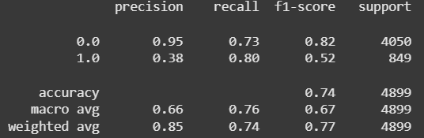
Question
6b. Examine the confusion matrix and classification report of the model in both the training and test datasets. Interpret the precision and recall metrics based on the confusion matrix. Is there a noticeable difference between the training and test datasets?
Answer
Because accuracy should not be the only measure, especially if our data is imbalanced, let's look specifically at the positive class:
- Precision 38% (not efficient)
Of all those predicted to take Paylater by the model, only 38% actually took Paylater.
- Recall 80% (effective)
The model successfully detected 80% of people who actually took Paylater
<br>
Business impact: Many people will be offered Paylater even though they are not interested (because precision is low) but most people who are interested will get an offer (high recall). So, the cost to acquire a customer using Paylater will be large.

Slide 42
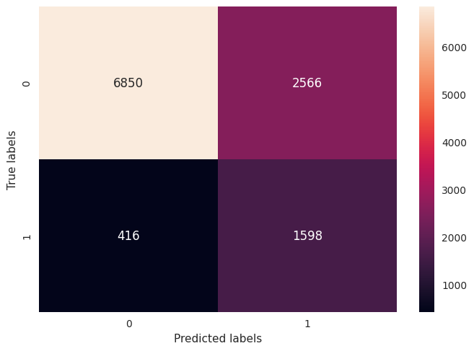

Question
6b. Examine the confusion matrix and classification report of the model in both the training and test datasets. Interpret the precision and recall metrics based on the confusion matrix. Is there a noticeable difference between the training and test datasets?
Data Train
Data Test

Slide 43
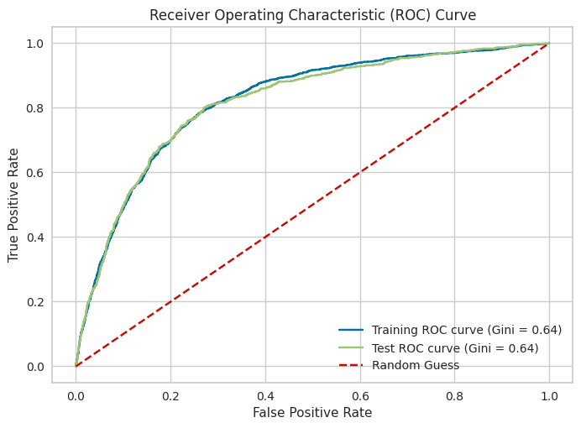
Question
6b. Examine the confusion matrix and classification report of the model in both the training and test datasets. Interpret the precision and recall metrics based on the confusion matrix. Is there a noticeable difference between the training and test datasets?
Answer
AUC Train 0.8218871889973245
AUC Test 0.8182806206284808
Gini Train 0.643774377994649
Gini Test 0.6365612412569617

Slide 44
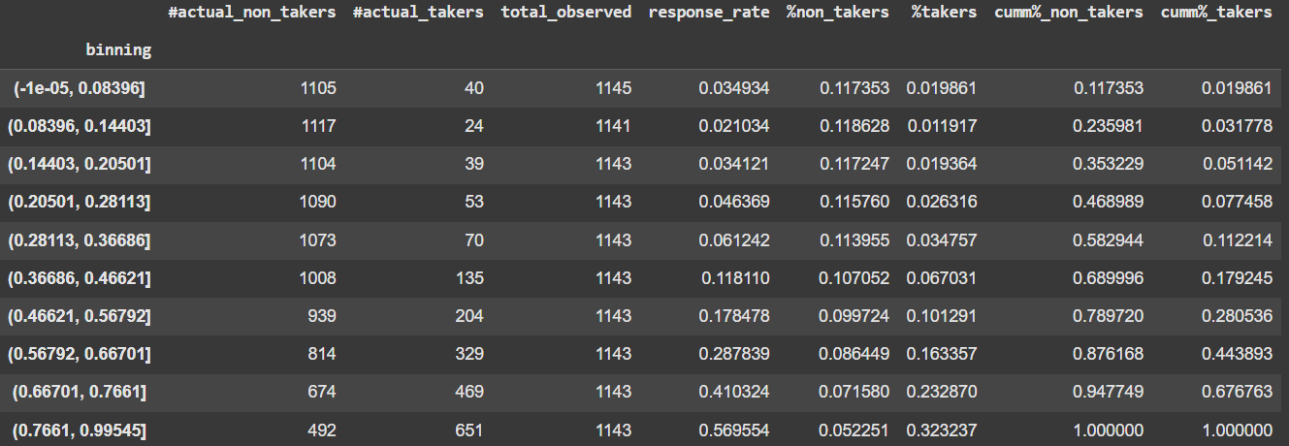
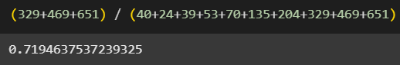
Question
6c. Produce a decile-based performance report for your model. Are there noticeable rank breaks among the deciles? Do the top deciles effectively identify the most promising Paylater customers?
Answer
Top deciles effectively can identify the most promising Paylater customer with :
- Just the top 3 deciles (the top 30% of people) account for about 71.9% of all actual Paylater users.
- That’s exactly the model is focusing in on the right people.
As the score binning increase, the number of real Paylater takers also increases a lot. It indicates higher model scores clearly mean more likely real users.

Slide 45
Question
6d. Based on the findings from the previous steps, conclude the suitability of your model in identifying the most promising Paylater customers
Answer
The model shows a strong ability to rank and identify Paylater users, especially from a business-targeting perspective:
Good general performance:
- Accuracy is 74% on the test set, which means the model correctly classifies the majority of cases.
- There's no clear sign of overfitting, since training and test accuracies are nearly identical (73.9% vs. 74%).
- However, the relatively moderate accuracy suggests there’s room for improvement — the model may be slightly underfitting.
Positive class analysis (Paylater users):
- High recall (80%) shows the model is effective at finding most of the actual Paylater users.
- Low precision (38%), however, means that many users predicted as interested actually are not, so it’s not very efficient. This could lead to a higher customer acquisition cost.

Slide 46
Question
6d. Based on the findings from the previous steps, conclude the suitability of your model in identifying the most promising Paylater customers
Answer
AUC and Gini scores confirm strong ranking ability:
- AUC on test: 0.818, Gini: 0.637
- These values indicate the model discriminates well between takers and non-takers.
Decile analysis supports effectiveness:
- Clear rank breaks are visible across deciles — the likelihood of a user taking Paylater increases steadily with model score.
- In fact, the top 3 deciles (just 30% of users) capture ~71.9% of all actual Paylater users, showing that the model accurately zeroes in on the most promising customers.
KS Statistic = 51
- Since a KS score above 40 is considered good, this value suggests the model has strong separation power between positive and negative classes.

Slide 47
Thank You
For Your Attention …
by
Batch
Assignment
Linkedin
Link
Ahmad Rizki
RevoU FSDA batch FEB25
Advance
Python
www.linkedin.com/in/arizabdulhanan
Google Collab Link

